Slide 1
Quick Mart
India’s Last Minute app

Slide 2
Project Overview:
Objective:
To analyse Quick Mart item sales performance across different outlet types, sizes, and geographic tiers in order to uncover insights that can help optimize product placement, outlet operations, and customer targeting strategies.
Business Context:
Quick Mart is a quick commerce platform serving diverse customer segments across India. With rapid expansion into Tier 2 and Tier 3 cities, understanding sales trends at a granular level is critical for supply chain, merchandising, and marketing decisions.

Slide 3
Key Goals:
•Evaluate sales trends by item type, fat content, and outlet characteristics.
•Identify high-performing outlet types, sizes, and locations.
•Understand how visibility, item count, and ratings affect performance.
•Leverage BI tools and programming to automate reporting and enhance data storytelling.
Outcome:
A dynamic dashboard (built using Power BI) with filterable views and performance KPIs, supported by Python, SQL, Excel, and Tableau for data prep, analysis, and visualization.

Slide 4
Tools & Technologies Used:
Excel: Initial data cleaning, pivot tables for quick summaries.
Power BI: Interactive dashboard with filters, charts, and KPIs. Report automation and PDF generation, data manipulation.
SQL: Data extraction, transformation, filtering outlet/item information.
Insights & Visualizations:
This section summarizes key findings derived from the Power BI dashboard, supported by data exploration in Excel and SQL. The dashboard allowed dynamic filtering by outlet type, size, location tier, and item characteristics.

Slide 5
Key Insights:
1.Tier 3 outlets generate the highest sales ($4300K), showing strong demand in semi-urban and rural areas.
2.Starchy Foods and Household are the top-performing item type, each contributing close to $389K in revenue.
3.Small-sized outlets account for 34.24% of total sales, suggesting that smaller formats attract more customers and have more inventory.
4.Low fat items lead with 52.39% of total item sales, while high-fat items represent a smaller but notable share.
5.Supermarket Type 2 and Grocery Stores outperform others, despite differences in item count and visibility.

Slide 6
6.Sales in Tier 2 cities are the lowest ($4300K), indicating possible market saturation or competition.
7.Outlet visibility has a direct impact on Grocery Stores item sales, especially in outlets.
8.Outlet establishment dipped in 2011, but has remained consistent post-2015, showing stable growth.
9.Item Type like Seafood and Hard Drinks have lower sales, highlighting potential areas for marketing or inventory review.
10.Item sales follow the 80/20 rule, where a few categories drive most of the revenue.

Slide 7
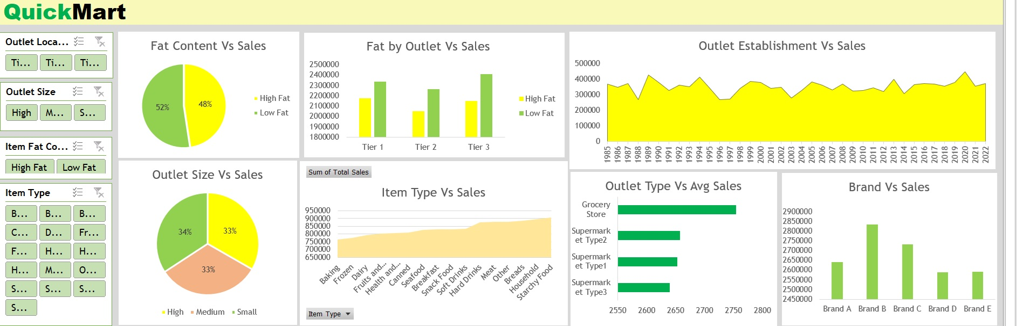
Excel Dashboard

Slide 8
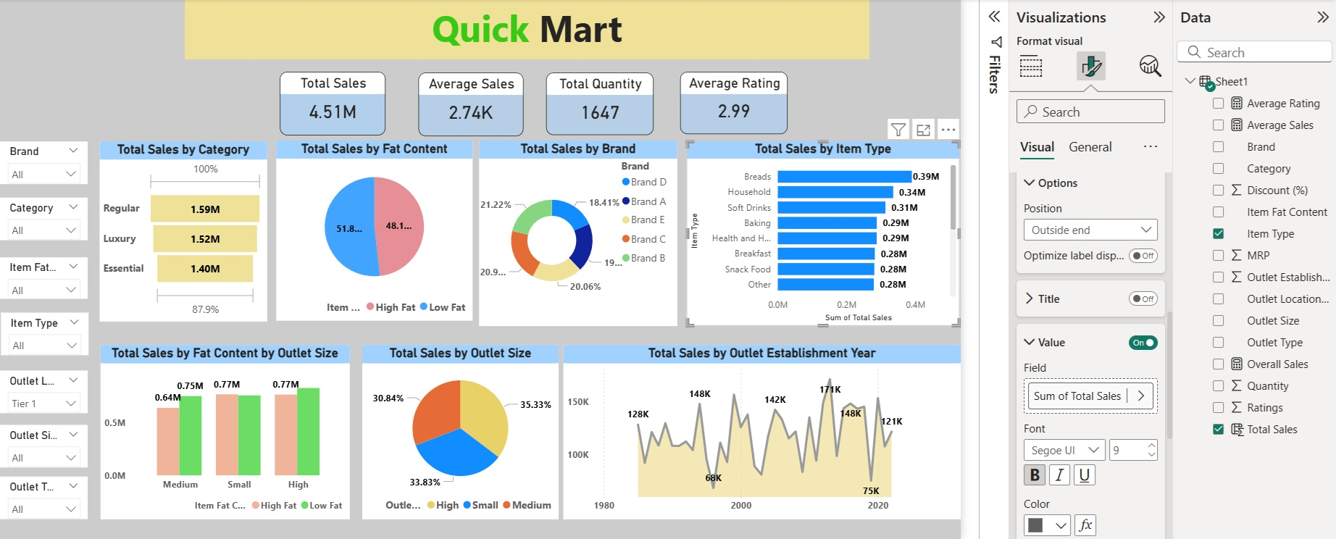
Power Bi Dashboard

Slide 9
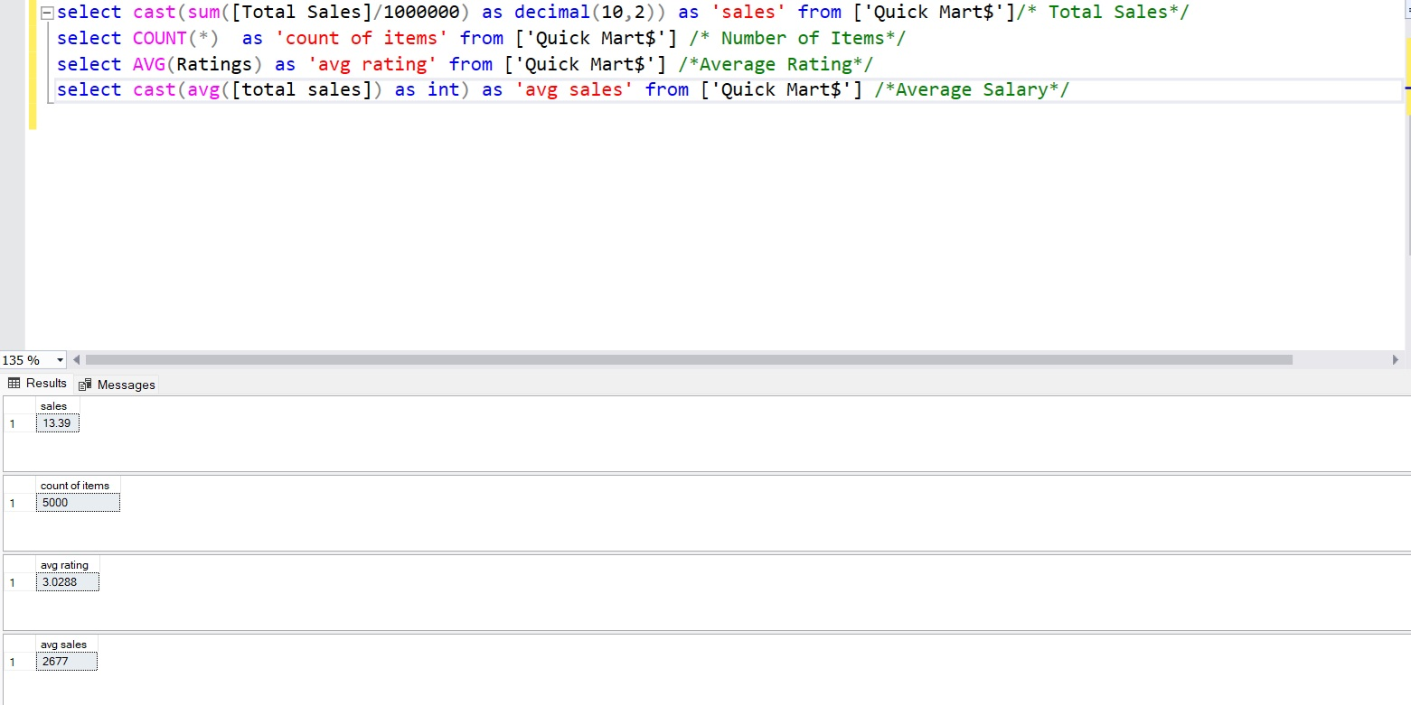
SQL Queries

Slide 10
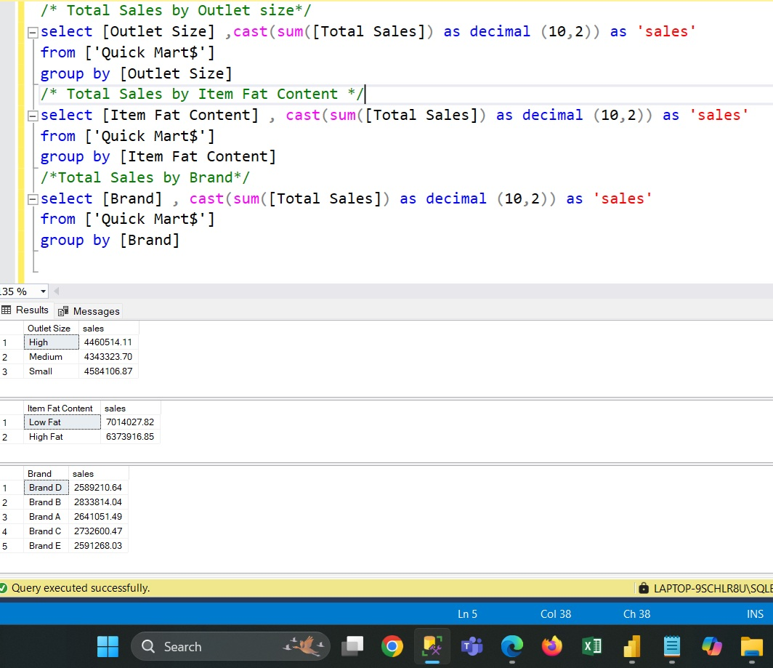

Slide 11
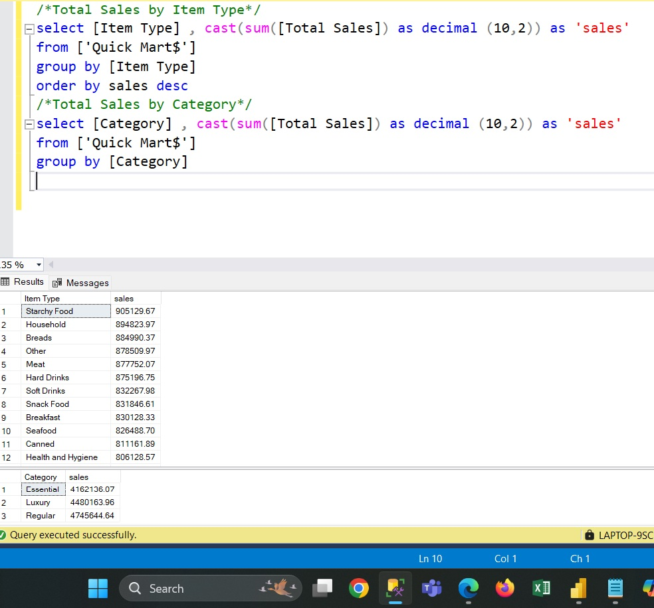

Slide 12
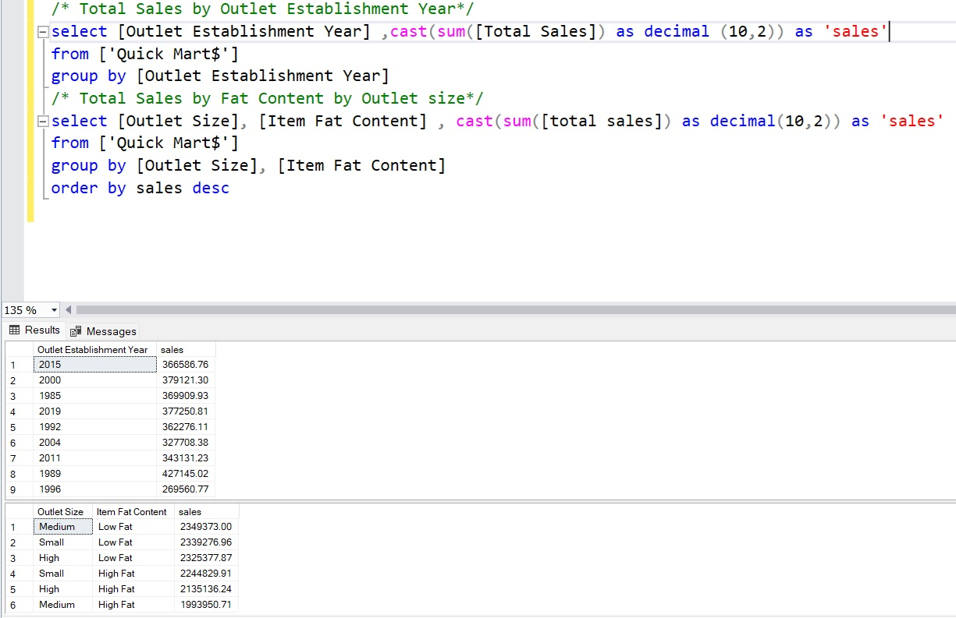

Slide 13
